Slide 1
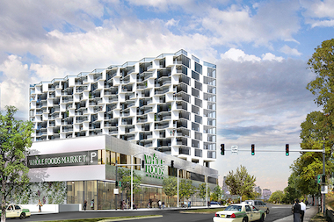


Quality of life & Housing affordability
Prof. David Albouy
(University of Illinois & NBER)

Slide 2
Inequality motivation
Inequality in well-being depends on many dimensions
Labor income
Non-labor income and wealth
Leisure
Prices (Costs-of-Living)
  Non-traded goods vary tremendously (Balassa-Samuelson)
  Housing rent perhaps the most important
Non-market goods/Household amenities
  Safety, cleanliness, climate, opportunities (schools), neighbors
  Often refer to the bundle of amenities as “Quality of Life”

Slide 3

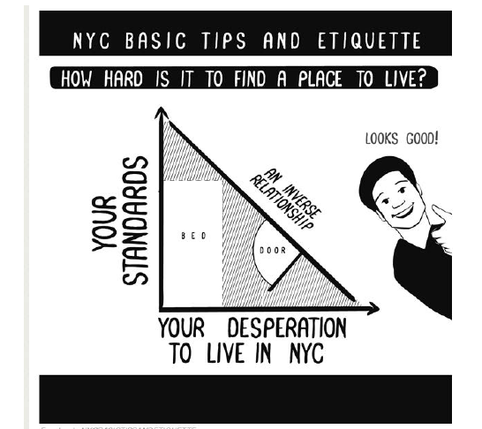
Distress over rising rents in many areas of the U.S. (& the world!)
Housing is a necessary
  Expenditure share larger for poor
The “rent is too damn high”!
-Jimmy McMillan
candidate for NYC mayor o
New York City offers something that many cities do not offer.
  Opportunities and amenities
  Rent is high for a reason
  Are these luxuries?
Physical dwelling vs. the location

Slide 4
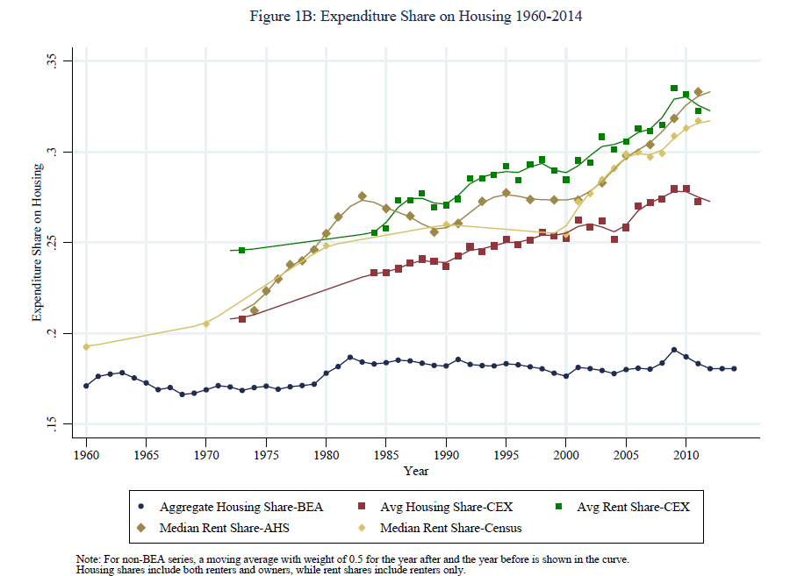
According to many measures, the expenditure share is rising especially for renters

Slide 5
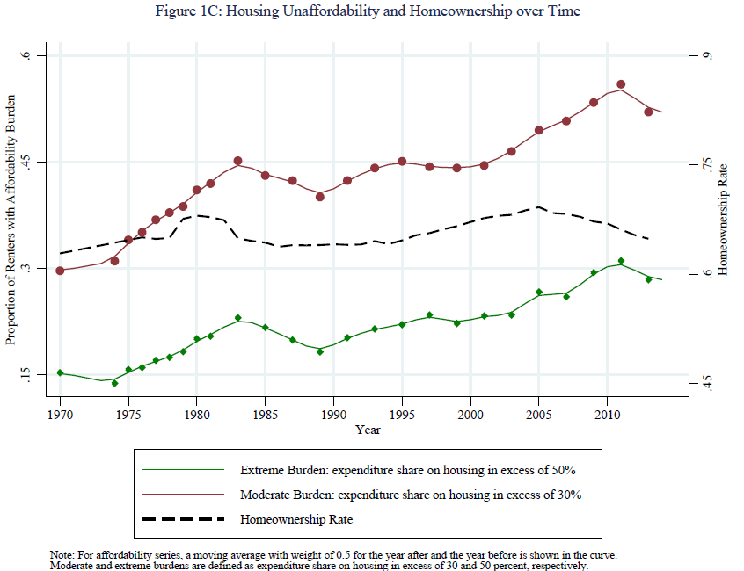
Measures of renter “unaffordability rise” while homeownership stagnates

Slide 6
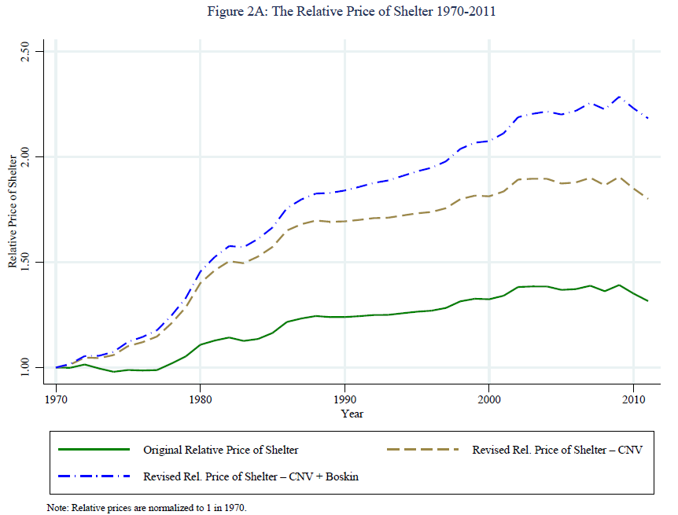
The relative price of shelter/housing is rising relative to other goods MORE than conventional statistics show, e.g. 3% per year rather than 1%!
Bias from conventional sampling methods
Bias from innovation and new products: Less innovation in housing
  Less

Slide 7
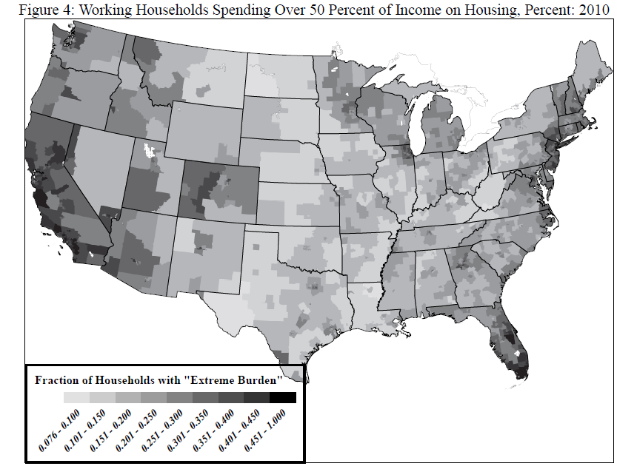
Unaffordability is concentrated in certain areas, particularly urban and coastal.

Slide 8
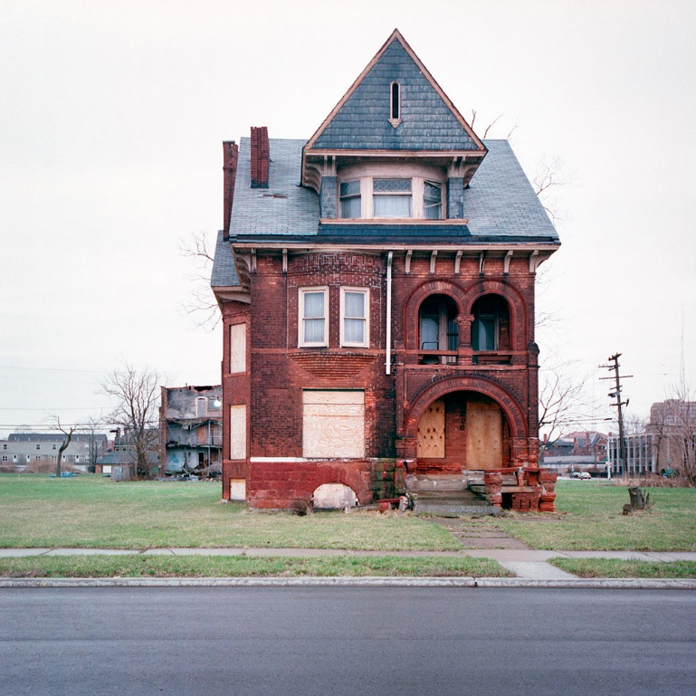

Where housing is maters more than how much housing!
City of Detroit
New York City
Median Price $13K
Median Price $1,600K

Slide 9
Detroit, 1970: Median Housing Value by Census Tract

Slide 10
Detroit, 2012: Median Housing Value by Census Tract

Slide 11
Los Angeles, 1970: Median Housing Value by Census Tract

Slide 12
Los Angeles, 2012: Median Housing Value by Census Tract

Slide 13
Overall trends in housing inequality (Albouy & Zabek 2016=5)

Slide 14
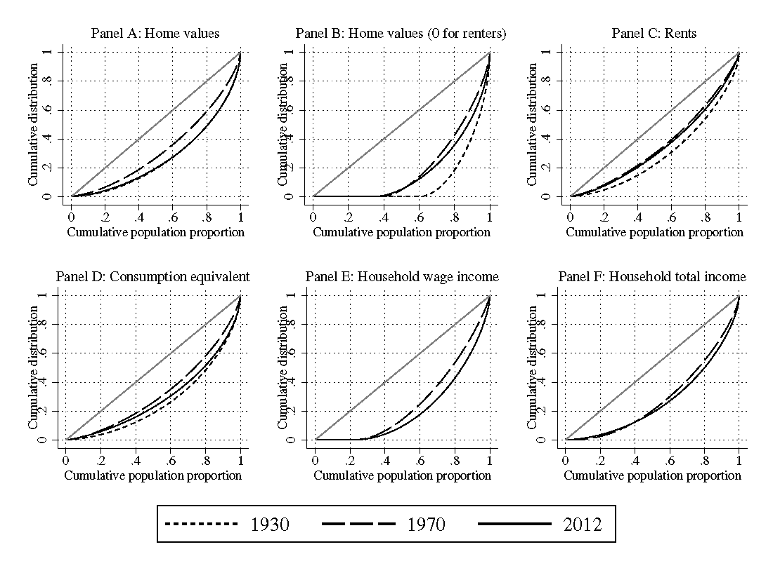
Gini Coefficients and Lorenz Curves: Some Long-Run Changes

Slide 15
Changes in housing inequality
Inequality fell sharply during “great convergence”
  Both in housing prices and rents
  Increase in home-ownership reduced wealth inequality
Inequality at its lowest in 1970
Growth to 2010 driven more by housing prices than rents
  Upper end of housing distribution more “out of reach”
  Lower end may be propped up by housing programs
Analysis suggests effects driven by location
  Dwelling characteristics explain nearly nothing
  Not about more unequal houses but unequal neighborhoods
  Are the rich paying more to be segregated?

Slide 16
The “big sort” & Tensions due to spatial equilibrium
Concern that there is growing divergence in locations
  Unskilled living far from skilled
  Holds particularly for natives (unskilled immigrants filling role for skilled natives in cities?)
Is the solution to housing affordability not to move people from New York to Detroit?
  Does not offer the same quality of life and opportunity
  Do the poor not care about amenities (are they a luxury?)
People are free to live where they want
  Market values reflect the desirability of the location
Changes in neighborhoods are creating tensions

Slide 17



Urban Revival & “Gentrification”:
A timely & controversial topic

Slide 18
“Gentrification maps” Suggest a long process
From Governing.com
To be eligible to gentrify, a tract's
  median household income and
  median home value
  within the bottom 40th percentile of all tracts
  within a metro area at the beginning of the decade.
Considered to have gentrified recorded
  increases in the top third percentile for
  median home values and
  percentage of adults with bachelors’ degrees

Slide 19
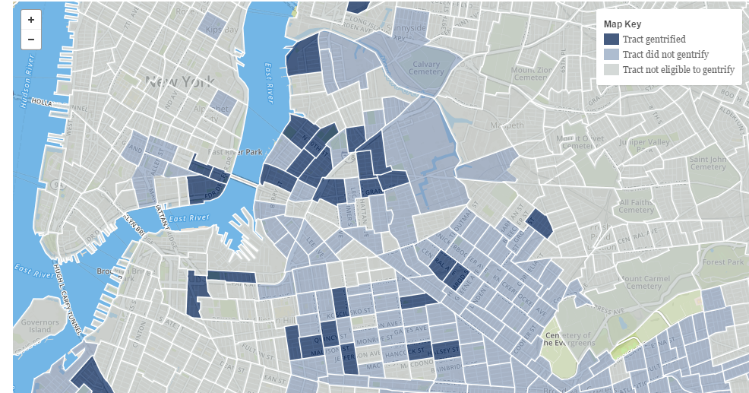
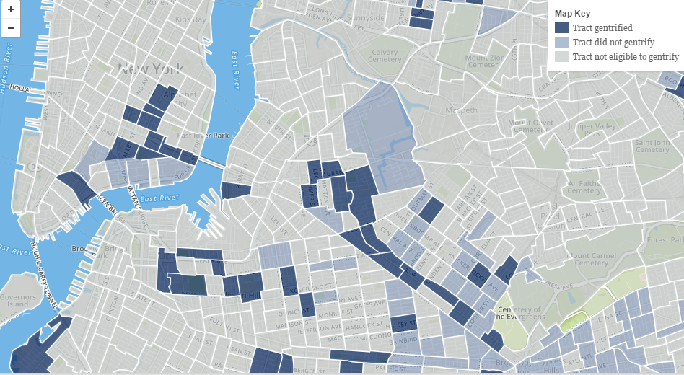
1990-2000
NYC: Lower Manhattan & Brooklyn
2000-2010

Slide 20
Where are the most unaffordable places?
Start with a general measure
  Based on local wages and prices
  Abstract from actual characteristics of people and dwellings
    E.g. with high potential earnings or small housing units
Costs-of-Living relative to wage levels
  Weight costs by expenditures
    Focus on housing rents
    Add additional factor to account for non-housing costs
      Missing data problems: may use rents to approximate latter.
  Weight wages by income share and net-of-tax rate
    Significant portion of income from non-wage sources
    Net wage differences softened by marginal tax rates (and transfers)

Slide 21
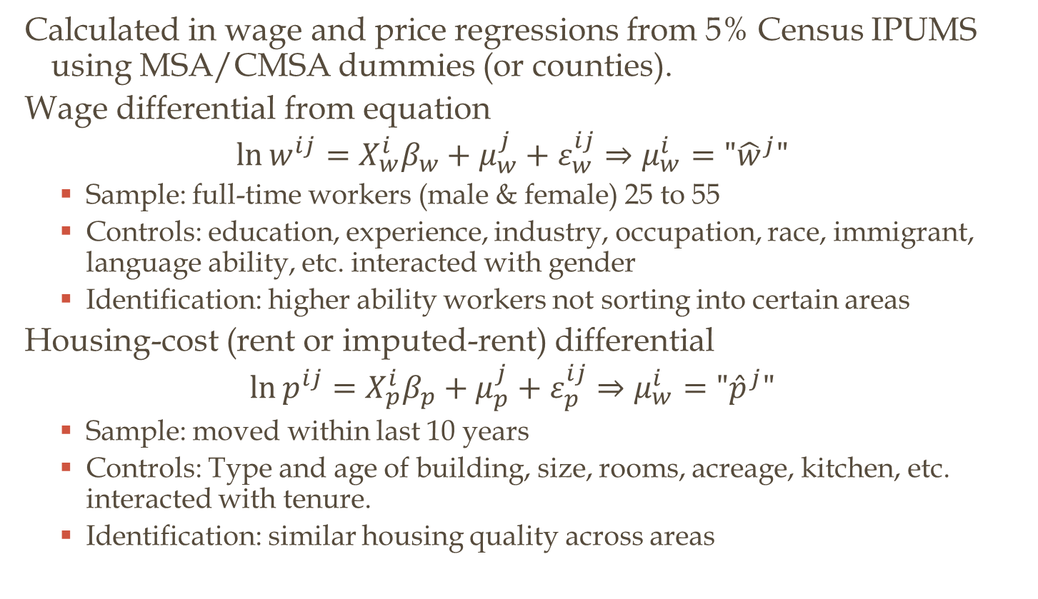
Wage and Housing-Cost Differentials
Calculated in wage and price regressions from 5% Census IPUMS using MSA/CMSA dummies (or counties).
Wage differential from equation
$$\ln{w^{ij}}=X_{w}^{i}β_{w}+μ_{w}^{j}+ε_{w}^{ij}⇒μ_{w}^{i}="{\hat{w}}^{j}"$$
  Sample: full-time workers (male & female) 25 to 55
  Controls: education, experience, industry, occupation, race, immigrant, language ability, etc. interacted with gender
  Identification: higher ability workers not sorting into certain areas
Housing-cost (rent or imputed-rent) differential
$$\ln{p^{ij}}=X_{p}^{i}β_{p}+μ_{p}^{j}+ε_{p}^{ij}⇒μ_{w}^{i}="{\hat{p}}^{j}"$$
  Sample: moved within last 10 years
  Controls: Type and age of building, size, rooms, acreage, kitchen, etc. interacted with tenure.
  Identification: similar housing quality across areas

Slide 23
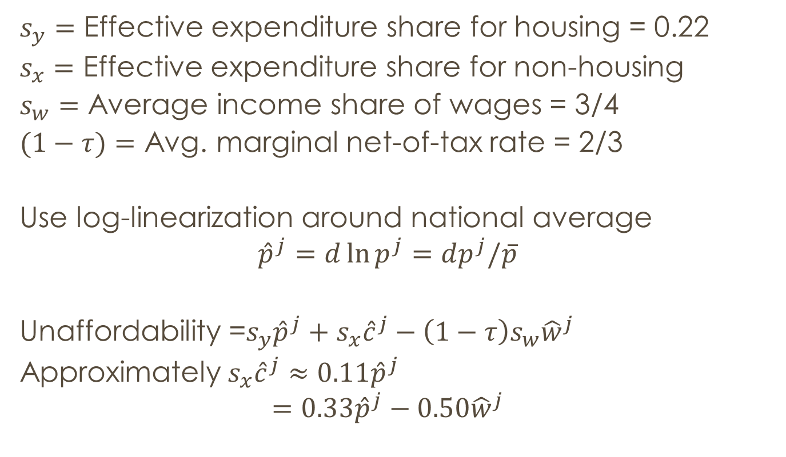
Unaffordability measure
$s_{y}=$ Effective expenditure share for housing = 0.22
$s_{x}=$ Effective expenditure share for non-housing
$s_{w}=$ Average income share of wages = 3/4
$(1−τ)=$ Avg. marginal net-of-tax rate = 2/3
Use log-linearization around national average
$${\hat{p}}^{j}=d\ln{p^{j}}=dp^{j}/\overline{p}$$
Unaffordability =$s_{y}{\hat{p}}^{j}+s_{x}{\hat{c}}^{j}−\left(1−τ\right)s_{w}{\hat{w}}^{j}$
Approximately$s_{x}{\hat{c}}^{j}≈0.11{\hat{p}}^{j}$
$$=0.33{\hat{p}}^{j}−0.50{\hat{w}}^{j}$$

Slide 24
Low affordability /market consumption
High affordability/
Market consumption
Albouy (2008)

Slide 25

The most unaffordable city is
HONOLULU!

Slide 26
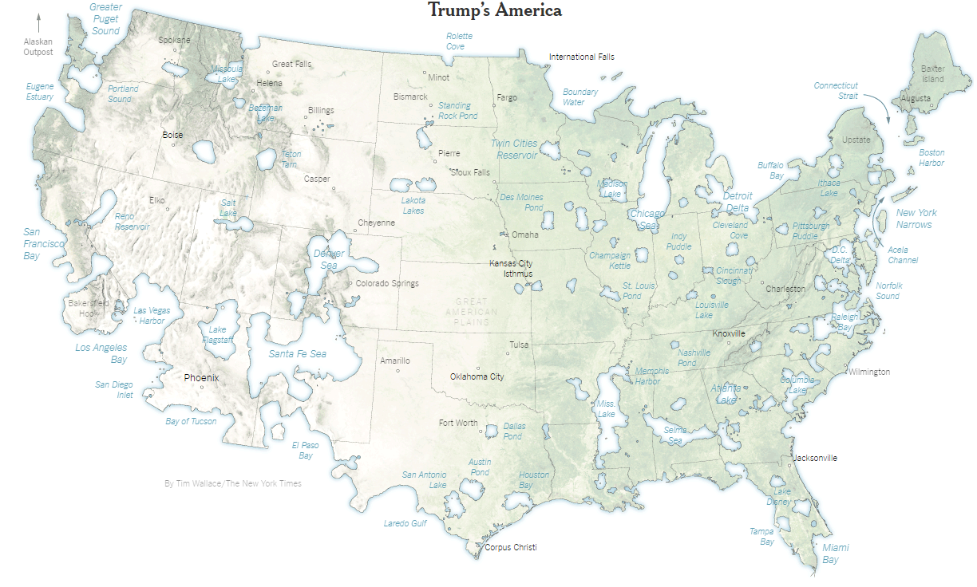
the most affordable areas?
Often rural or small cities

Slide 27
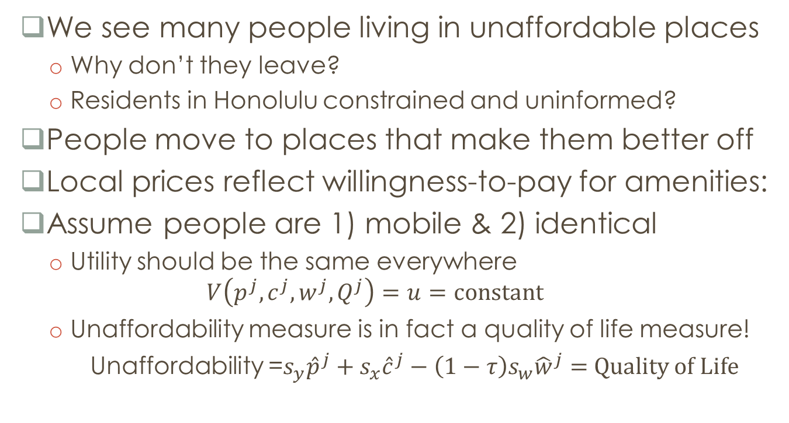
Mobility generates a “paradox” of affordability & quality of life
We see many people living in unaffordable places
  Why don’t they leave?
  Residents in Honolulu constrained and uninformed?
People move to places that make them better off
Local prices reflect willingness-to-pay for amenities:
Assume people are 1) mobile & 2) identical
  Utility should be the same everywhere
  $$V\left(p^{j},c^{j},w^{j},Q^{j}\right)=u=constant$$
  Unaffordability measure is in fact a quality of life measure!
  Unaffordability =$s_{y}{\hat{p}}^{j}+s_{x}{\hat{c}}^{j}−\left(1−τ\right)s_{w}{\hat{w}}^{j}=$ Quality of Life

Slide 28
Amenable City with Lump-Sum Taxes: Miami vs. Columbus
Land
rent
Mobility
condition:
lump-sum
taxes
Zero-profit condition:
average productivity
wage

Slide 29
Amenable City with Wage Taxes: Miami vs. Columbus
Land
rent
Mobility
condition:
lump-sum
taxes
Workers enter Miami
Mobility
condition:
wage taxes
Zero-profit condition:
average productivity
wage

Slide 30
Low affordability /
High quality of life
High affordability/
Low quality of life
Albouy (2008)

Slide 31
Quality of life rankings
1. Honolulu
2. Santa Barbara
4. San Francisco
8. San Diego
15. Los Angeles
39. Denver
51. New York
81. Chicago
217. Detroit
268. Houston
Within-metro areas?
  Make adjustment for commuting and wage by place of work
  Considerable heterogeneity within metro areas
    Famous neighborhoods do show up as being nice places to live (Beverly Hills, Upper East Side)

Slide 32
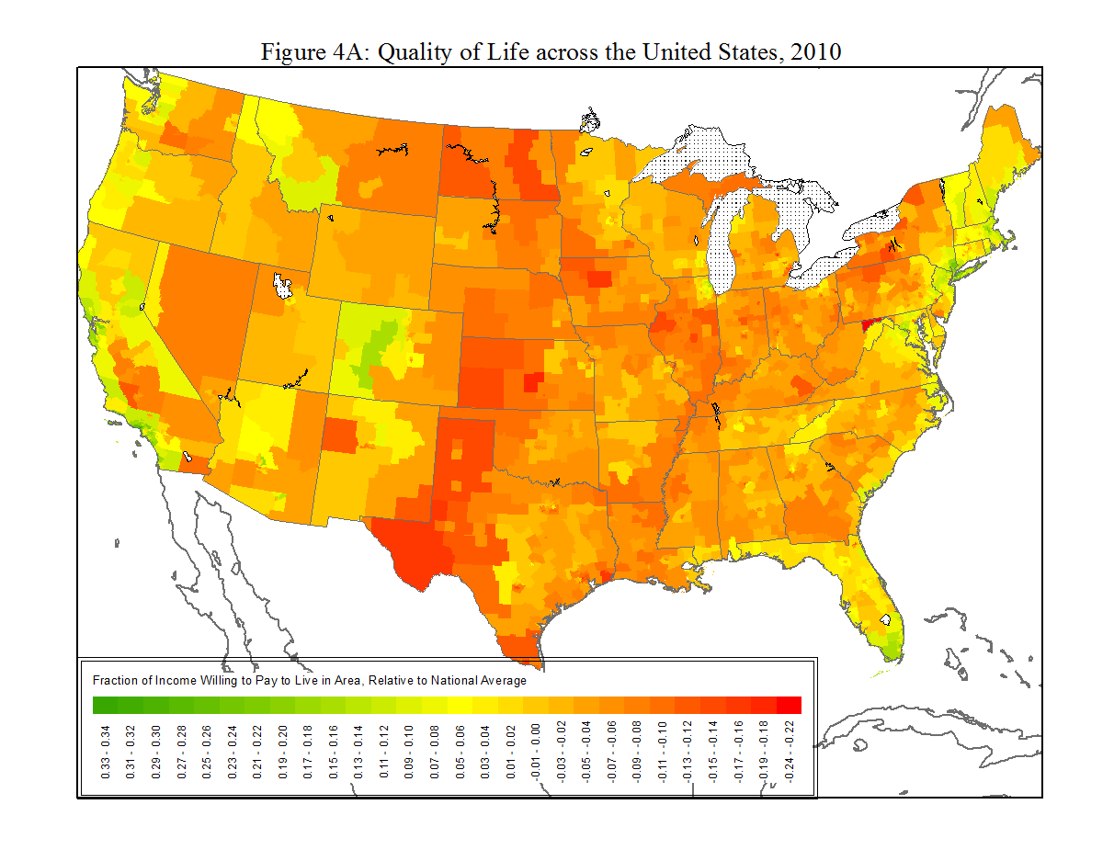

Slide 33
the most affordable areas?
Often rural or small cities

Slide 34
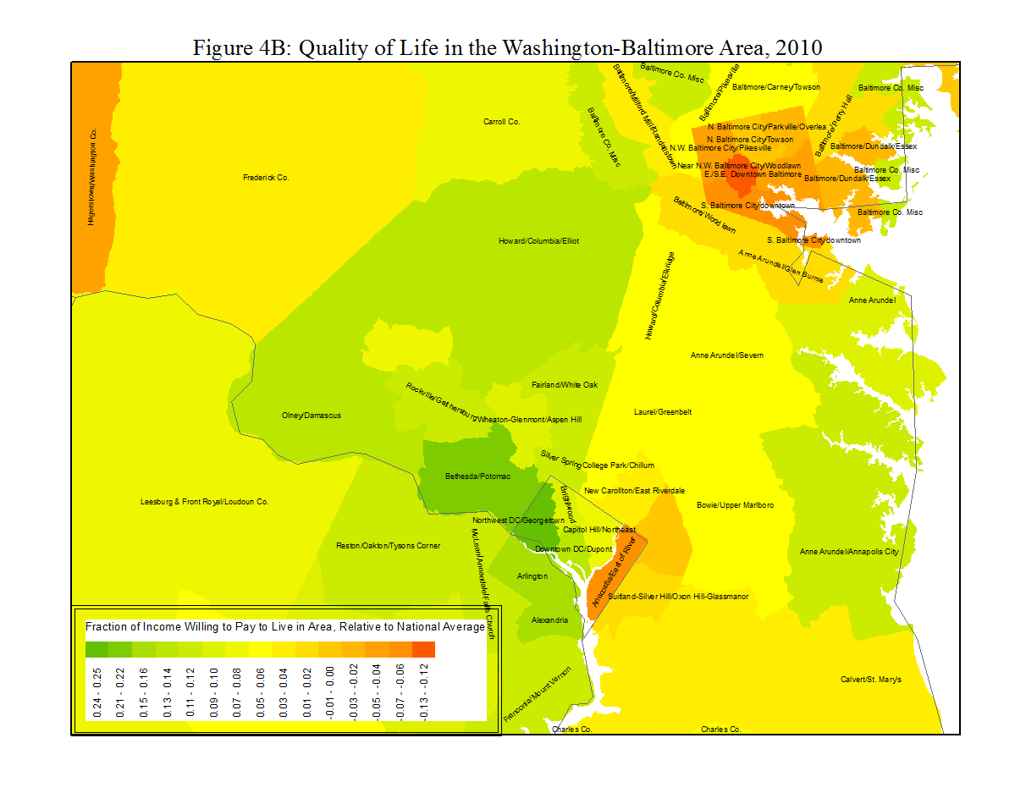


Slide 35
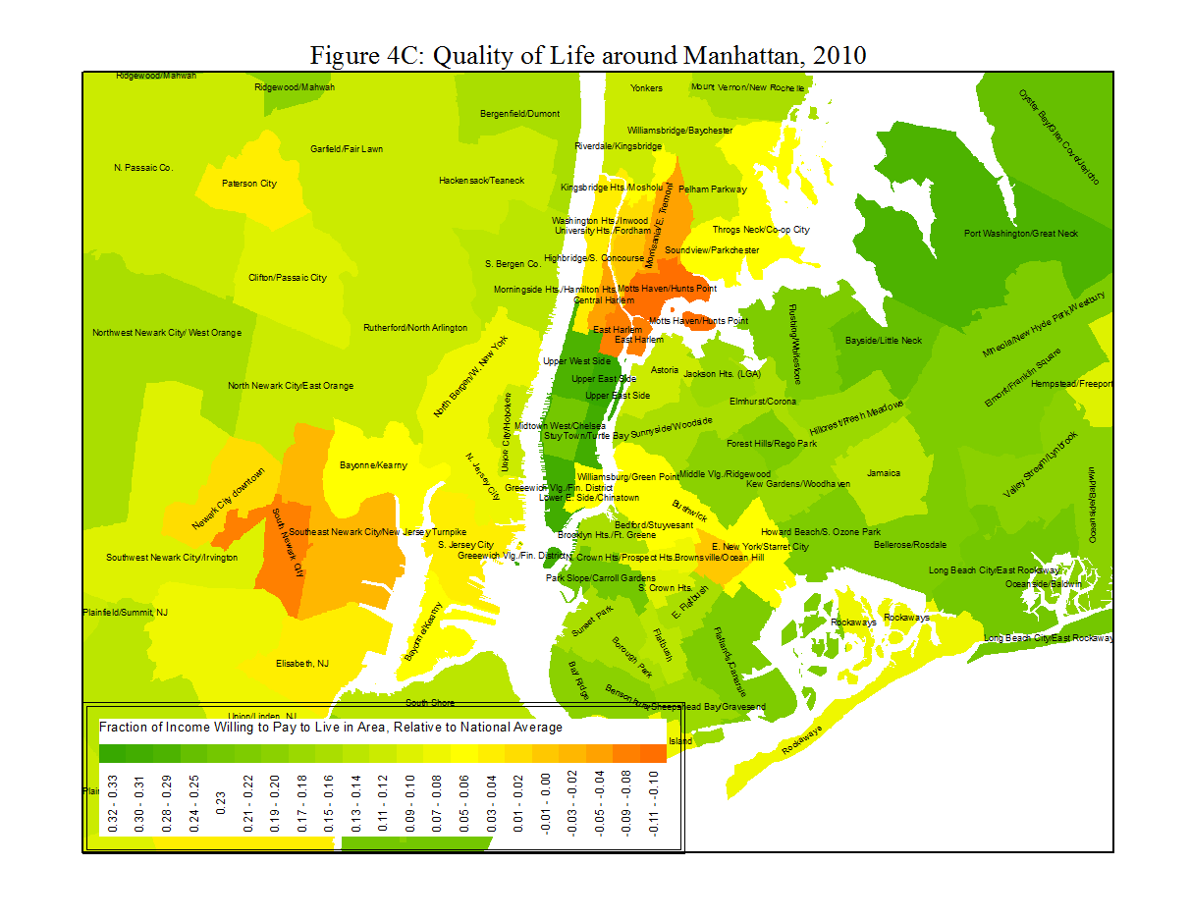


Slide 36
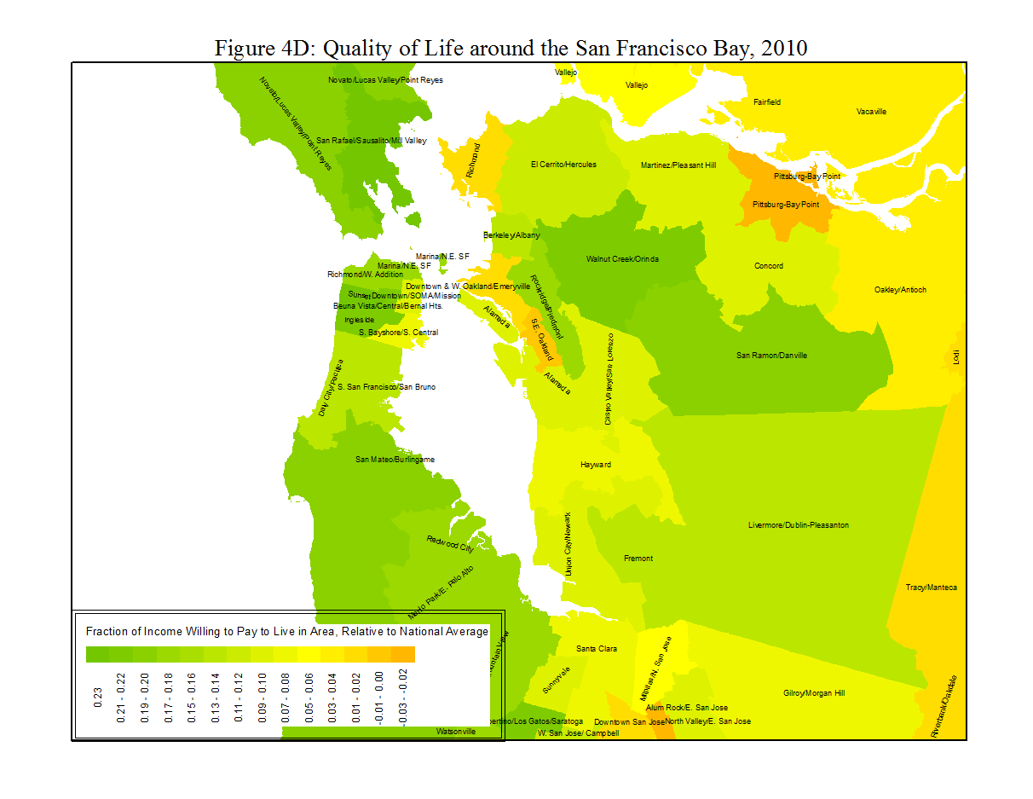
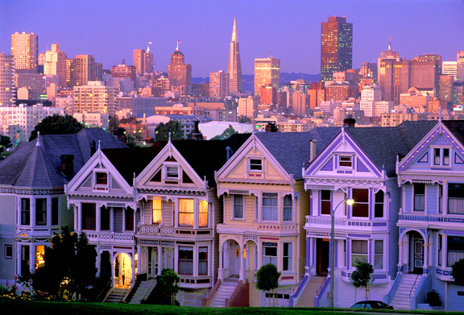

Slide 37
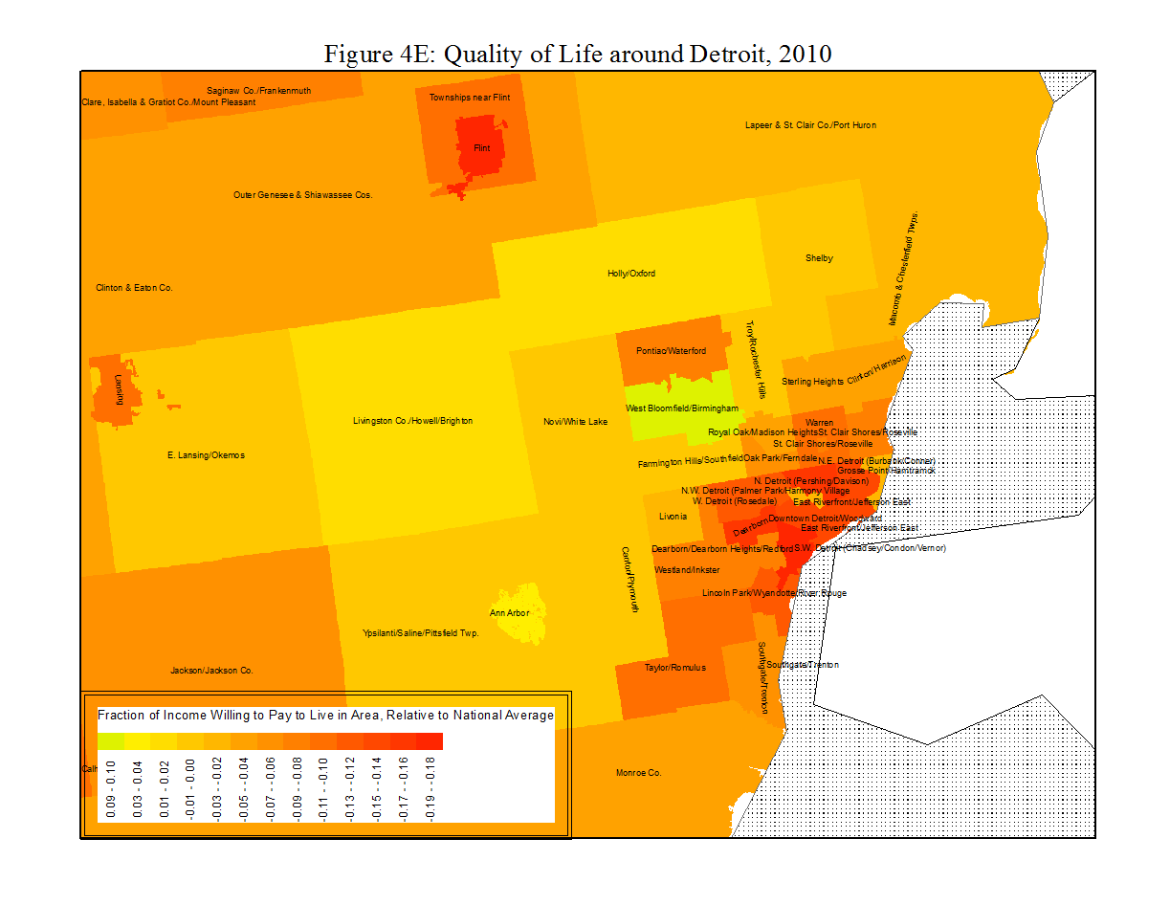
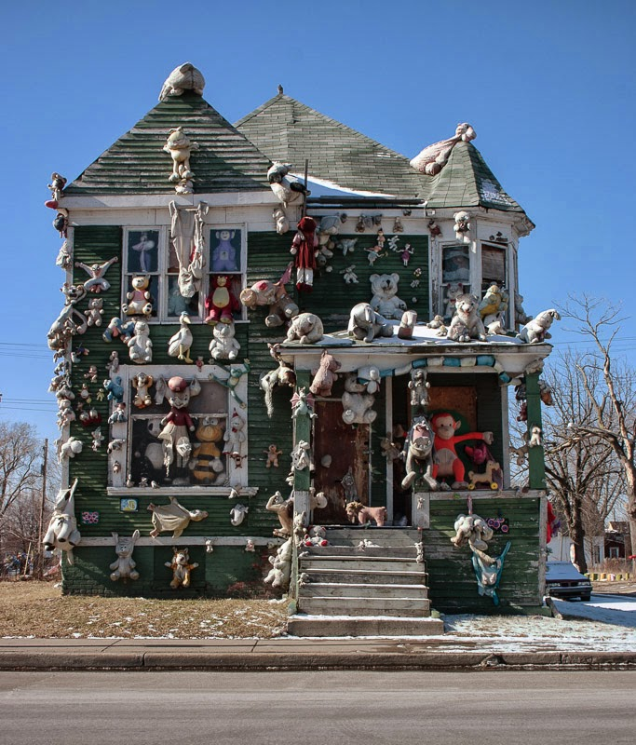

Slide 38
What amenities account for quality of life?
Any local characteristics could potentially apply
Natural: climate, geography
Artificial: culture, government, environment…
Conventional quality of life measures often use several categories
  Each combined of sub-metrics
PlacesRated Almanac (7th ed)
Climate
Ambience
Recreation
Crime
Transportation
Education
Health Care
Housing Costs*
Job Outlook*

Slide 39


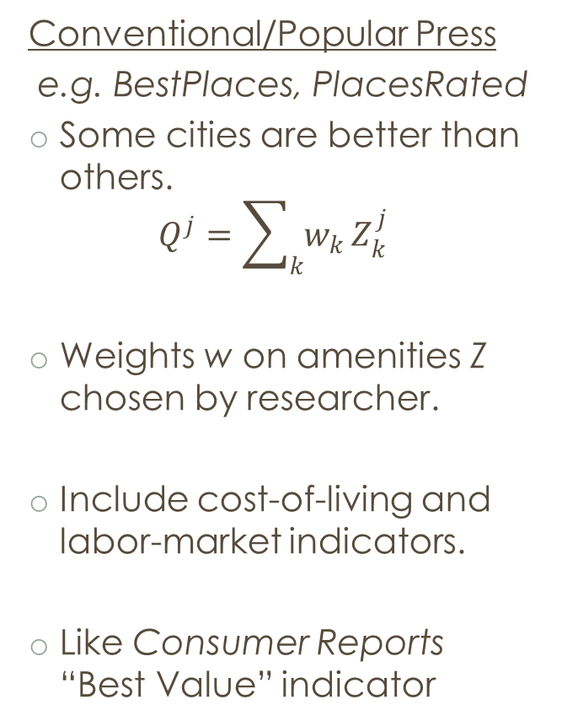
Quality-of-Life and amenities
Conventional/Popular Press
e.g. BestPlaces, PlacesRated
Some cities are better than others.
$$Q^{j}=\sum_{k}{w_{k}}Z_{k}^{j}$$
Weights w on amenities Z chosen by researcher.
Include cost-of-living and labor-market indicators.
Like Consumer Reports “Best Value” indicator
Revealed-Preference/Hedonics
e.g. Rosen (1979), Albouy (2008)
All cities equally good.
High QOL compensated with higher cost-of-living relative to income i.e. lower market consumption
Weights w on amenities estimated through lower real incomes
Good separated from the price.

Slide 40
Best Places to Live according to
Cities Ranked & Rated (2nd ed)
PlacesRated Almanac (7th ed)
Pittsburgh, PA
San Francisco, CA
Seattle-Bellevue-Everett, WA
⁞
18. New York, NY-NJ
⁞
Ann Arbor, MI
⁞
Chicago-Naperville-Joliet, IL
⁞
178. Detroit-Livonia-Dearborn, MI
⁞
255. Champaign-Urbana, IL
⁞
379. Goldsboro, NC
Gainesville, FL
Bellingham, WA
Portland-Vanouver, OR-WA
Colorado Spring, CO
Ann Arbor, MI
⁞
New York, NY-NJ
⁞
101. Champaign-Urbana, IL
⁞
Chicago-Naperville-Joliet, IL
⁞
344. Detroit-Livonia-Dearborn,MI
⁞
373. Modesto, CA

Slide 41

Pittsburgh:
#1 Most livable City
(really?)

Slide 42
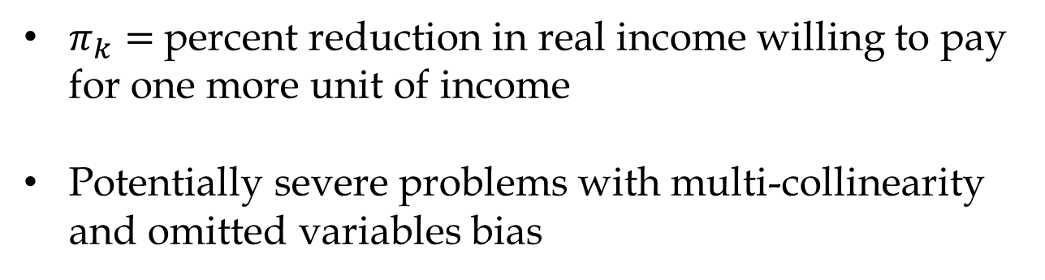
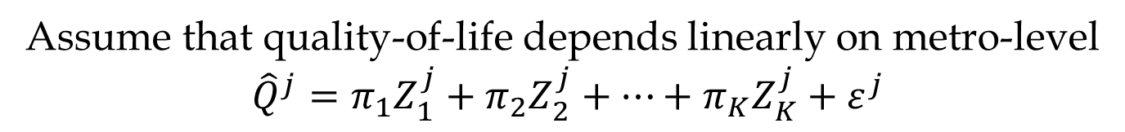
Valuing amenities with city-level regressions
Assume that quality-of-life depends linearly on metro-level
$${\hat{Q}}^{j}=π_{1}Z_{1}^{j}+π_{2}Z_{2}^{j}+…+π_{K}Z_{K}^{j}+ε^{j}$$
$π_{k}=$percent reduction in real income willing to pay for one more unit of income
Potentially severe problems with multi-collinearity and omitted variables bias

Slide 43
Simple linear hedonic estimates
Albouy & Lue 2015
Find positive values, with economically significant coefficients.
Climate & geography account for 2/3 of variation ACROSS metro areas.
Interpret carefully!
Omitted variables
Non-linearities
Interactions
Endogeneity
 |  | QOL
Dependent Variables |  | by PUMA
Minus 1000s of Heating Degree Days, 65F base |  | 0.022***
(mean = 4.50, sd = 2.25) |  | (0.001)
Minus 1000s of Cooling Degree Days, 65F base |  | 0.043***
(mean = 1.25, sd = 0.91) |  | (0.003)
Sunshine, percent possible |  | 0.157***
(mean = 0.060, sd = 0.078) |  | (0.021)
Inverse distance to coast |  | 0.115***
(mean = 0.71, sd =0.14) |  | (0.017)
Average Slope of Land, in percent |  | 0.608***
(mean = 1.80, sd = 2.22) |  | (0.068)
Minus Murder Rate per 1,000 |  | 0.133***
(mean = 0.05, sd = 0.053) |  | (0.033)
Restaurants and Bars per Thousand |  | 0.029***
(mean = 1.71, sd = 0.28) |  | (0.004)
Public School Revenues per Student, $10,000s |  | 0.117***
(mean = 0.50, sd = 0.13) |  | (0.010)
R-squared |  | 0.41
Number of Observations |  | 1948

Slide 44
Application: How might climate amenities change welfare?
By 2100 average welfare loss is 2.52% of income under A2 scenario (std dev = 0.69%)
5th degree linear spline
Albouy et al. 2015
R² = 0.822

Slide 45
Categorical equity and environmental Justice
Quality-of-life index aggregates non-market goods into a single index.
Is this a sufficient statistic for welfare?
  E.g. can we compensate for poor environment with $$$?
Non-welfarist objections
  Categorical equity: certain goods should be distributed equitably, e.g. public school
  Environmental justice: amenities towards disadvantaged communities
    Compensation inadequate
    Not interested in consumer sovereignty

Slide 46
Preference heterogeneity across observed types
Do skilled and unskilled value amenities the same?
  Beach, opera, ski lodges, universities, air quality, safety.
With perfect mobility the mobility condition should hold for each type!
  With different shares and wage (and cost?) measures.
  Housing a necessity: unskilled pay more for amenities
  Relative wage measures
Relative quantities of workers only matter with some kind of friction.

Slide 47
With Friction Relative Supply curve is upward sloping:
divides places relatively attractive to unskilled vs. skilled
Attractive to unskilled
Attractive to skilled

Slide 48
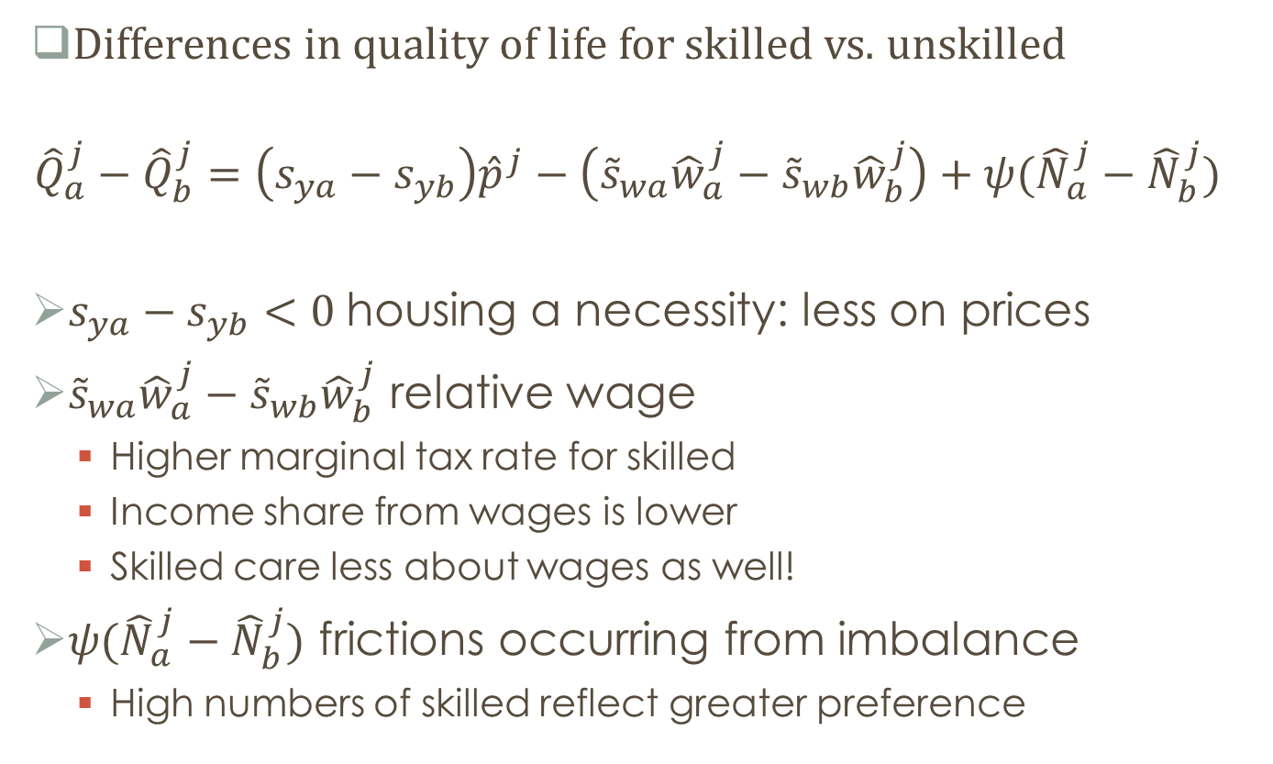
Relative differences in quality of life
Differences in quality of life for skilled vs. unskilled
$${\hat{Q}}_{a}^{j}−{\hat{Q}}_{b}^{j}=\left(s_{ya}−s_{yb}\right){\hat{p}}^{j}−\left({\tilde{s}}_{wa}{\hat{w}}_{a}^{j}−{\tilde{s}}_{wb}{\hat{w}}_{b}^{j}\right)+ψ({\hat{N}}_{a}^{j}−{\hat{N}}_{b}^{j})$$
$s_{ya}−s_{yb}<0$housing a necessity: less on prices
${\tilde{s}}_{wa}{\hat{w}}_{a}^{j}−{\tilde{s}}_{wb}{\hat{w}}_{b}^{j}$ relative wage
  Higher marginal tax rate for skilled
  Income share from wages is lower
  Skilled care less about wages as well!
$ψ({\hat{N}}_{a}^{j}−{\hat{N}}_{b}^{j})$ frictions occurring from imbalance
  High numbers of skilled reflect greater preference

Slide 49
What cities to the skilled value relatively most?
Name | Relative QOL
San Francisco | 0.07
Washington/Baltimore | 0.07
Boston | 0.04
Chicago | 0.03
New York | 0.01
Detroit | 0.00
Los Angeles | -0.02
Houston | -0.03
Miami | -0.05
Las Vegas | -0.05

Slide 50
Preliminary evidence suggests skilled value mild summers, culture, and clean air; Less skilled want to be closer to the coast! (“Jersey-Shore effect”?)
Amenity | Relative QOL
Minus 1000s of Heating Degree Days, 65F base | -0.00238
 | (0.00265)
Minus 1000s of Cooling Degree Days, 65F base | 0.0194***
 | (0.00693)
Sunshine, percent possible | 0.125**
 | (0.0592)
Inverse distance to coast | -0.182**
 | (0.0713)
Average Slope of Land, in percent | -0.000351
 | (0.00277)
Restaurants and Bars per Thousand | 0.0111
 | (0.0220)
Places Rated Arts & Culture Index/100 | 0.138***
 | (0.0125)
Minus Median Air Quality Index/100 | 0.158***
 | (0.0280)
Safety from Violent Crime Index | -0.00279
 | (0.00557)
Safety from Property Crime Index | -0.00940
 | (0.00591)
Observations | 245
R-squared | 0.561

Slide 51
Is spatial mobility reasonable?
Not everyone is fully mobile
  Younger, educated more mobile
  Moving costs and spatial preference heterogeneity a hot topic
  Time period is important (we all came from Africa!)
For equilibrium to hold enough people must be mobile for prices to adjust?
  This may be reasonable
  Especially if more mobile put pressure on prices for less mobile
  I would argue, it holds decently well for U.S., Canada, U.K., and Germany based on similar QOL studies
Consider a more nuanced example using housing expenditures

Slide 52
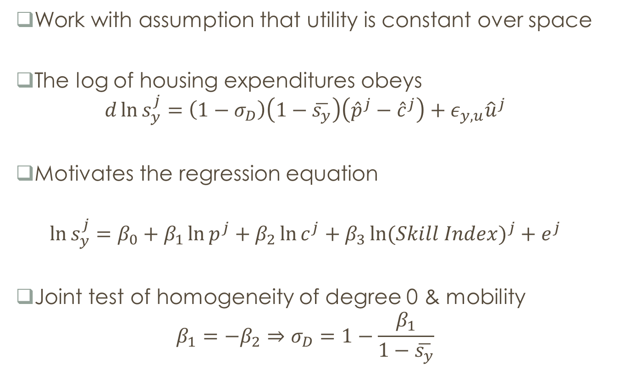
A compensated-demand Housing expenditures over space
Work with assumption that utility is constant over space
The log of housing expenditures obeys
$$d\ln{s_{y}^{j}}=\left(1−σ_{D}\right)\left(1−\overline{s_{y}}\right)\left({\hat{p}}^{j}−{\hat{c}}^{j}\right)+ε_{y,u}{\hat{u}}^{j}$$
Motivates the regression equation
$$\ln{s_{y}^{j}}=β_{0}+β_{1}\ln{p^{j}}+β_{2}\ln{c^{j}}+β_{3}\ln{{(Skill Index)}^{j}}+e^{j}$$
Joint test of homogeneity of degree 0 & mobility
$$β_{1}=−β_{2}⇒σ_{D}=1−\frac{β_{1}}{1−\overline{s_{y}}}$$

Slide 53
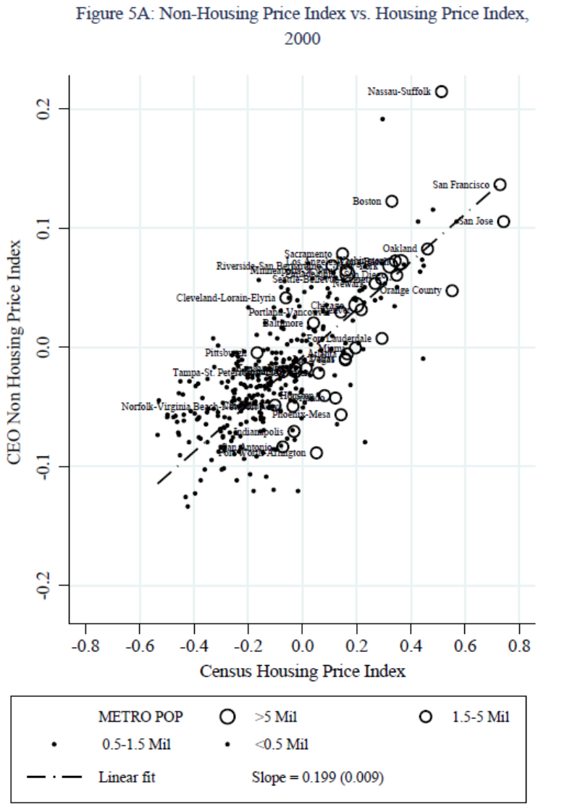
Variation in housing and non-housing costs.
Expenditure shares increase with rent levels: imply inelastic demand

Slide 54
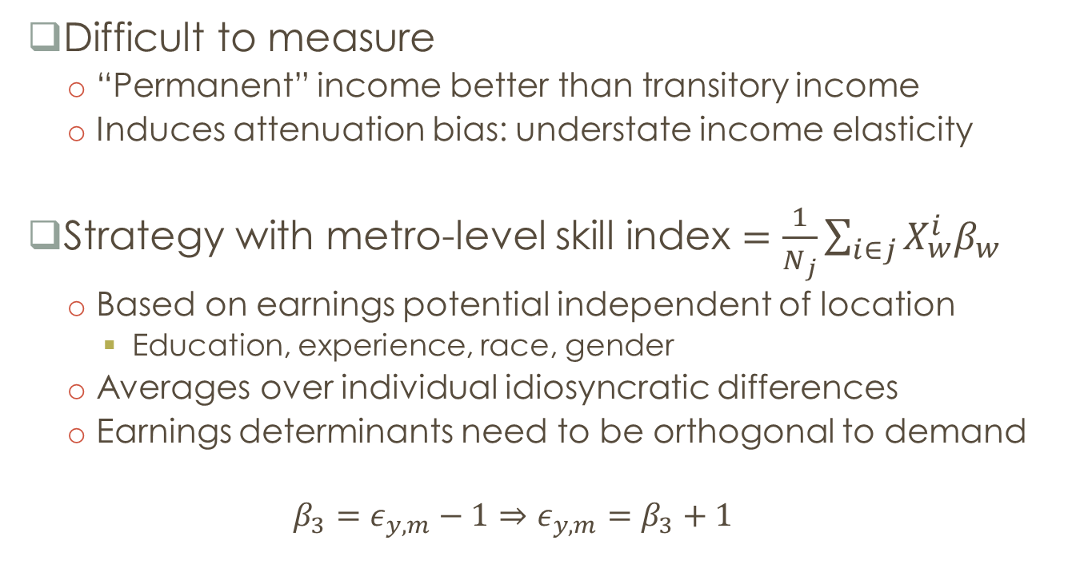
Income elasticity of housing
Difficult to measure
  “Permanent” income better than transitory income
  Induces attenuation bias: understate income elasticity
Strategy with metro-level skill index $=\frac{1}{N_{j}}\sum_{i∈j}{X_{w}^{i}β_{w}}$
  Based on earnings potential independent of location
    Education, experience, race, gender
  Averages over individual idiosyncratic differences
  Earnings determinants need to be orthogonal to demand
  $$β_{3}=ε_{y,m}−1⇒ε_{y,m}=β_{3}+1$$

Slide 55
Dependent variable: median log rent share of income by metro area
Renters have uncompensated price elasticity -2/3, income elasticity 2/3
Panel A: Regression Results
Rental/Housing Price Index |  | 0.172 | 0.233 | 0.239 | 0.246
 |  | (0.026) | (0.029) | (0.027) | (0.027)
Non-Housing Price Index |  |  | -0.185 | -0.239 | -0.246
 |  |  | (0.087) | (0.027) | (0.027)
Skill/Predicted Wage Index |  |  | -0.298 | -0.282 | -0.287
 |  |  | (0.108) | (0.112) | (0.112)
Homeownership Rate |  |  |  |  | 0.079
 |  |  |  |  | (0.061)
Constant |  | -1.492 | -1.492 | -1.492 | -1.492
 |  | (0.006) | (0.004) | (0.004) | (0.004)
Sample Size (number of areas) |  | 331 | 331 | 331 | 331
Adjusted R-squared |  | 0.297 | 0.518 | 0.519 | 0.524
Homogeneity of Demand Restricted |  | No | No | Yes | Yes
P-value of Test of Homog. of Demand |  |  | 0.504 | 0.504 | 0.519
Panel B: Implied Demand Parameters
Geometric Mean Expenditure Share |  | 0.225 | 0.225 | 0.225 | 0.225
 |  | (0.001) | (0.001) | (0.001) | (0.001)
Income Elasticity of Housing Demand |  | 1.000 | 0.702 | 0.718 | 0.713
 |  | Restrict | (0.108) | (0.112) | (0.112)
Elasticity of Substitution Between Housing and Consumption Goods σ |  |  |  | 0.692 | 0.683
 |  |  |  | (0.034) | (0.035)

Slide 56
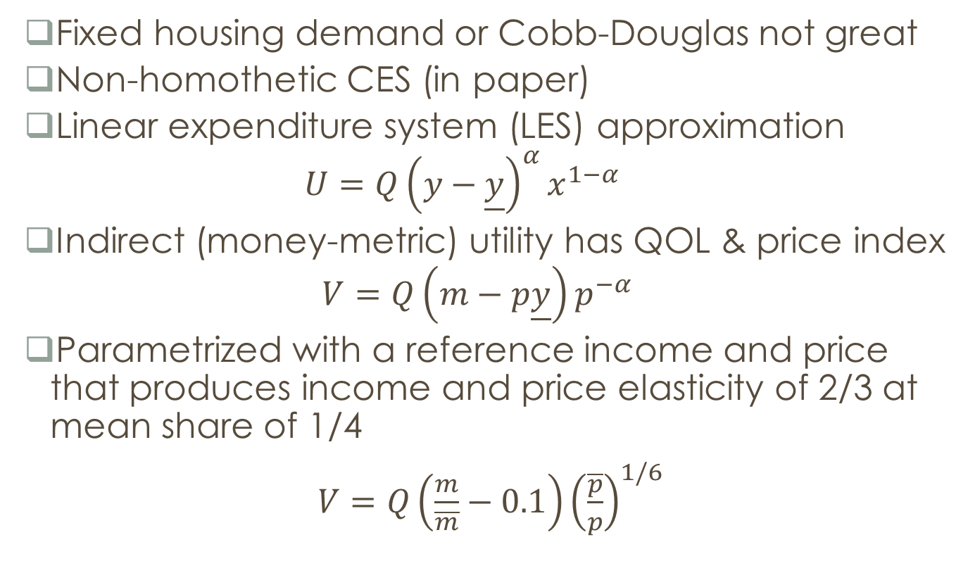
Implications for household demand
Fixed housing demand or Cobb-Douglas not great
Non-homothetic CES (in paper)
Linear expenditure system (LES) approximation
$$U=Q{\left(y−\underline{y}\right)}^{α}x^{1−α}$$
Indirect (money-metric) utility has QOL & price index
$$V=Q\left(m−p\underline{y}\right)p^{−α}$$
Parametrized with a reference income and price that produces income and price elasticity of 2/3 at mean share of 1/4
$V=Q\left(\frac{m}{\overline{m}}−0.1\right){\left(\frac{\overline{p}}{p}\right)}^{1/6}$

Slide 57
Ideal cost-of-living index relationship with rent
  Limited curvature from substitution
  Greater slope for the poor due to housing necessity
Expensive cities more expensive for poor.
Over time, rising prices and widening inequality explain much of the “affordability crisis” faced by renters

Slide 58
Non-homothetic cost-of-living adjustment implies that costs-of-living rose by 9 (6) percent more for those at the 10th (50th) percentile relative to 90th percentile.
- 90-10 income inequality rose by 25% more than income measures suggest
TABLE 6: CHANGES IN REAL INCOMES 1970-2010 BY INCOME PERCENTILES IDEALLY DEFLATED
Household Position | Income Ratio 2009/1970 | Ideal Deflator | Ideal Deflated Income | Deflated Fixed Bundle | Ideal Correction to Fixed
CPI revised with CNV & Boskin
10th Percentile | 6.103 | 4.871 | 1.253 | 1.226 | 0.026
50th Percentile | 6.002 | 4.747 | 1.265 | 1.206 | 0.058
90th Percentile | 7.869 | 4.640 | 1.696 | 1.581 | 0.114
Official CPI
10th Percentile | 6.103 | 5.466 | 1.116 | 1.120 | -0.003
50th Percentile | 6.002 | 5.411 | 1.109 | 1.101 | 0.008
90th Percentile | 7.869 | 5.364 | 1.467 | 1.444 | 0.023

Slide 59
Implications of rising housing costs
Lower productivity growth in housing relative to other goods is hurting the poor more than the rich.
Why low productivity growth
  Partly technological
    Moore’s Law does not apply to housing production
    Land is limited in supply: can’t expand with population & income
    Nicest areas tend to be coastal or mountainous
  Arguably much is man-made
    Massive growth in land-use restrictions over the last century
    Supposedly to improve quality of life (or exclude the poor)

Slide 60
Housing production & the social cost of land-use restrictions
Higher quality of life places tend to have higher regulatory costs of housing.
  Is the effect causal?
  Controlling for natural amenities: relationship is zero!
  Typical regulations do not appear to increase quality of life
Regulations do raise housing costs!
  Albouy and Ehrlich: create gap between housing prices and input costs from land and non-land inputs
Political economy suggestive
  Regulations may have a small private benefit to existing residents.
  Little overall value, since not valued by outsiders.
  Outsiders cannot vote to improve affordability!

Slide 61
Can we improve affordability & quality of life?
Expand housing production in amenable areas
  Natural amenities – can benefit everyone
    Temperature, sunshine, coastline, hilliness largely exogenous
    Policies that hinder (ease) their consumption may lower (improve) welfare.
    The poor care about these about as much as rich!
      At a sunny beach, we may all be more equal ☺
    Housing restrictions are hurting the young skilled & unskilled…
  Artificial amenities – not clear
    Depend on the population
    May change as populations shift, e.g. crime, pollution
    Depends on a complex model of social interactions
    Deserves further research!

